Slide 1
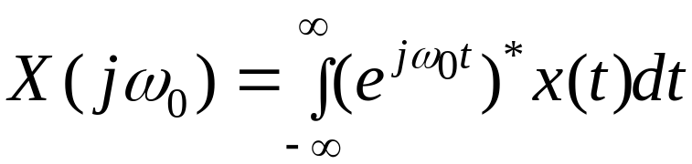


Fourier Transforms Revisited
Consider the Fourier representation of a doubly infinitely long signal
This expression essentially answers the question
“Is there a sinusoid in “
Professor A G Constantinides©

Slide 2

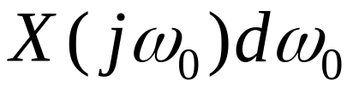
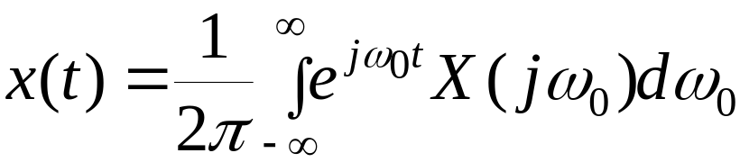
Fourier Transforms Revisited
Also it says
“ There is a sinusoid of amplitude in the infinitely long signal “
The implication is that can be written as a “sum” of weighted sinusoids
Hence the inverse form that combines the sinusoids to give the infinite long signal is
Professor A G Constantinides©

Slide 3
Fourier Transforms Revisited
Sinusoids are
  orthogonal
  infinitely long
  complete
  deterministic
Orthogonality means that a representation of a signal in terms of sinusoidal waveforms leads to a “least squares” problem, i.e. with a finite number of terms we have the best approximation of a given signal in the least square sense.
Professor A G Constantinides©

Slide 4
Fourier Transforms Revisited
Orthogonality also means that if we take a finite number of terms in an approximate representation, and we wish to take one more term then the previously calculated weighting coefficients remain unaffected.
We need only calculate the weight attached to the additional term
Professor A G Constantinides©

Slide 5
Fourier Transforms Revisited
If we have finite duration signals which we try to represent in terms of infinitely long sinusoids we would expect to have problems.
This is because the representation expects the signal to extend to infinity in both directions
But it falls to zero outside its support, and at those points there are deviations (Gibbs ripples)
Professor A G Constantinides©

Slide 6
Fourier Transforms Revisited
We can think of the finite duration signal as the product of a top-hat window and an infinitely long signal
Thus the spectrum of the infinitely long signal is “smeared” (see your PSD lectures) by the sinc function form of the spectrum of the top-hat window.
One consequence is that one cannot discern the existence of a “line” in the spectrum of the given signal (see “uncertainty” shortly)
Professor A G Constantinides©

Slide 7
Fourier Transforms Revisited
Completeness means that if we take infinite number of terms in our representation then we would get an expression which is “identical” to the given signal
Identity in this case means that in the least square sense nothing will be left behind ie the error becomes zero
Professor A G Constantinides©

Slide 8
Fourier Transforms Revisited
Deterministic means that we have an exact value of the signal at every point in time which may be got notionally from a formula
Therefore it is not appropriate to use sinusoids, as they are, to represent finite duration stochastic, non-stationary signals (eg real world signals such as speech!)
Either some modifications are to be made, or a new framework of representation to be devised
Professor A G Constantinides©

Slide 9
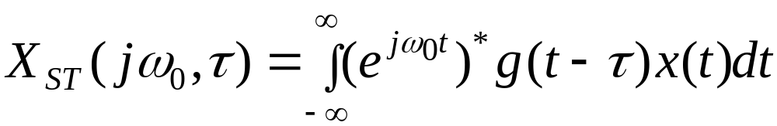
STFT
If the given signal is of finite bandwidth (rather than finite duration) then similar observations can be made but now with repect to the time-domain behaviour
The Short-Time Fourier Transform is a modification of the normal FT that responds to these needs
Professor A G Constantinides©

Slide 10

STFT
Where is a window shifted to the temporal position of interest
Observe that now we have lost orthogonality and possibly completeness of representation
The ideas of finite duration and bandwidth may be represented on a time-frequency figure as follows
Professor A G Constantinides©

Slide 11

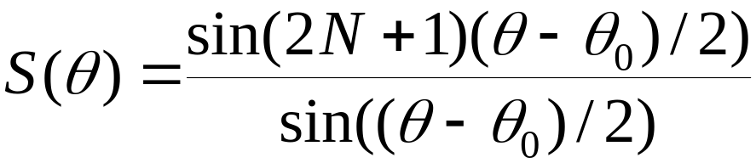
Uncertainty
Principle of Uncertainty in Signals
Consider a sinusoidal signal and take a finite segment in time, from –N to +N
Its spectrum is then
Professor A G Constantinides©

Slide 12

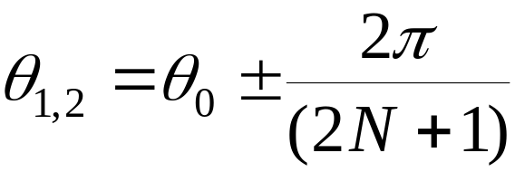
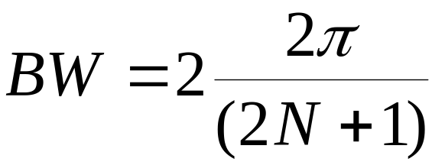
Uncertainty
The main lobe is located between the frequencies
Or
And hence its bandwidth is
Professor A G Constantinides©

Slide 13
Uncertainty
It is clear that as the number of terms (i.e. duration of the signal) increases the bandwidth decreases in a reciprocal fashion
Thus the frequency of the signal becomes more precisely defined as the signal length tends to infinity.
Professor A G Constantinides©

Slide 14
Uncertainty
We can represent these ideas on a time-frequency diagram.
The ideal case (infinite duration)
Infinite duration
frequency
Zero width
time
Professor A G Constantinides©

Slide 15
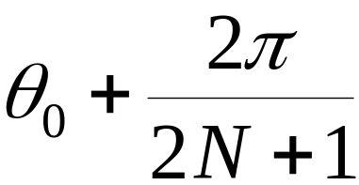
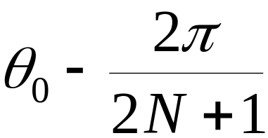


Wavelets
The finite bandwidth and duration case
finite duration
frequency
time
finite width
Professor A G Constantinides©

Slide 16
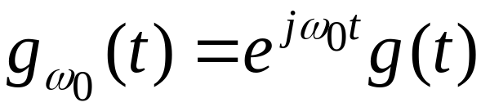
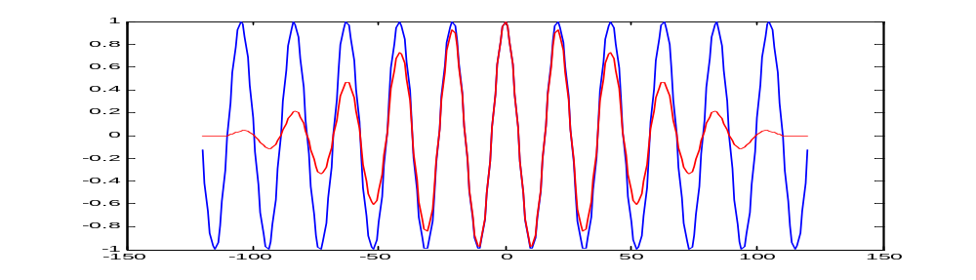

Wavelets
time
frequency
Professor A G Constantinides©

Slide 17
Wavelets
If the DFT is used to analyse a signal the frequency resolution cannot be better than the DFT bin-width
With finite length signals the diagram becomes
frequency
1
0.8
0.6
0.4
0.2
0
time
Professor A G Constantinides©

Slide 18
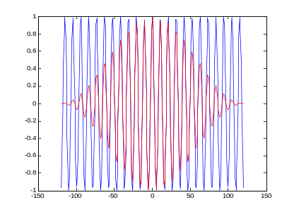
Wavelets
Thus if we have a general signal located in the region –N,+N we can “Fourier” (STFT) analyse using DFT.
The time-frequency diagram would be
Signal duration
Signal bandwidth
frequency
time
Professor A G Constantinides©

Slide 19

Wavelets
The “Fourier” analysis is now called the Short Time Fourier Transform (STFT) and it essentially asks the following question:
“Is there a short period sinusoidal wavefom of frequency in the given signal and where is it located in time?”
Clearly a filtering interpretation of the STFT is possible
Professor A G Constantinides©

Slide 20
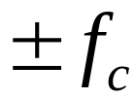

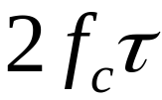
Degrees of Freedom
Signals
  bandlimited to and
  of finite duration
  (These quantities need to be defined properly and are related to uncertainty!)
Need parameters for the complete description
Thus the basic time-frequency rectangle can be divided in any way we desire so long as the total area is covered
Professor A G Constantinides©

Slide 21
Degrees of Freedom
Possible partitions
frequency
time
Professor A G Constantinides©

Slide 22
Gabor Logons
Other partitions are possible (Dennis Gabor, Imperial College 1946)
frequency
time
Professor A G Constantinides©

Slide 23
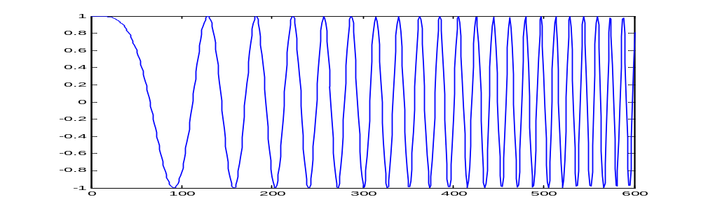
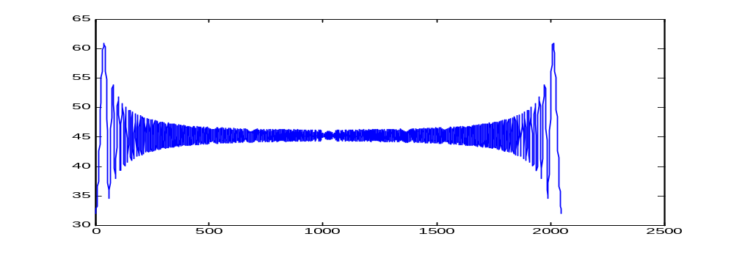
Linear Chirp & FFT
Take a linear chirp and its FFT
Professor A G Constantinides©

Slide 24
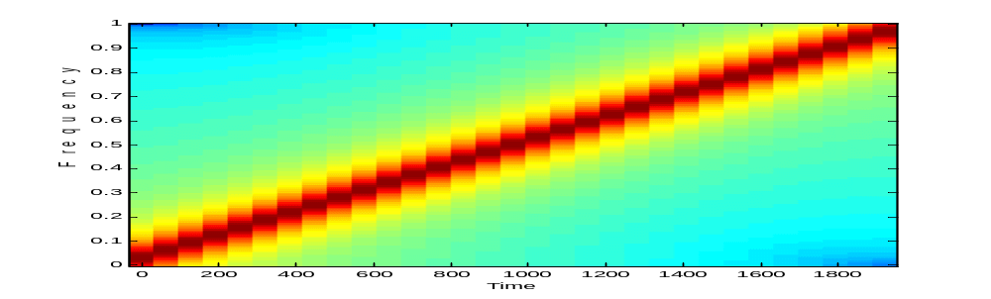
Linear Chirp & STFT
Linear chirp and STFT
Professor A G Constantinides©

Slide 25
Wavelets
In a frequency partitioning there is no need to retain all samples per band, as the sampling theorem is satisfied with fewer (in M frequency strips we need retain only 1 in M samples)
Hence further partitions are possible
Professor A G Constantinides©

Slide 26




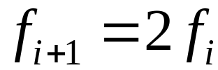
Wavelets
A typical alternative is (others are possible!)
frequency
time
Professor A G Constantinides©

Slide 27
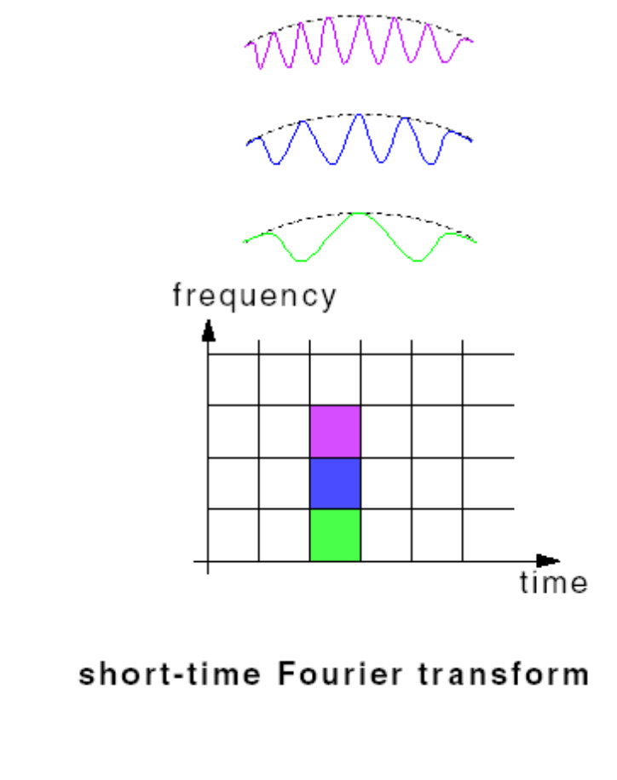
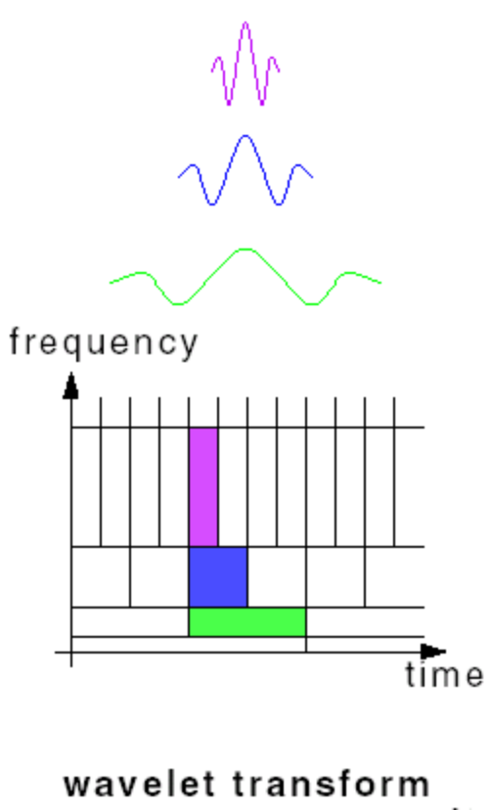
STFT and Wavelets
Professor A G Constantinides©

Slide 28
STFT and Wavelets
New partition recognises the following needs:
1) At high frequencies we would like the time location of events in the signal to be made precise (ie longer data records)
2) while at low frequencies we would like the frequency resolution to be more accurate (ie longer normalised bandwidths)
Professor A G Constantinides©

Slide 29
Wavelets
Contrive to select the new functions over the time-frequency support of each, to be orthogonal
The mathematical form of the representation is very similar to the STFT
Professor A G Constantinides©

Slide 30
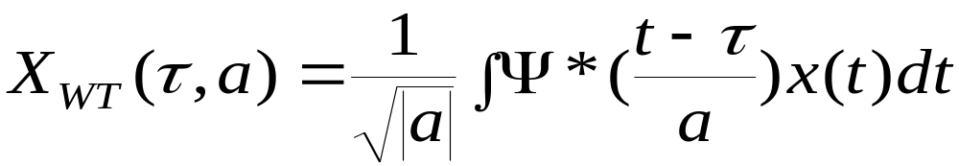
Continuous Wavelet Transform
Compare with the STFT we looked at earlier
The similarities are strikingly obvious!!!
Professor A G Constantinides©

Slide 31
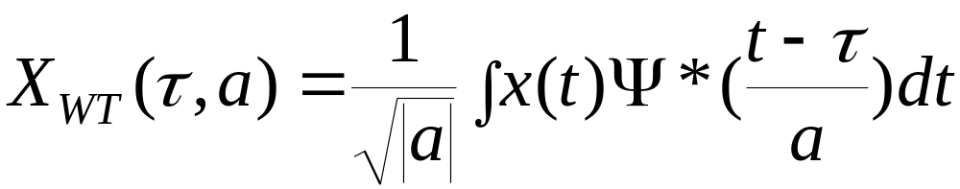
Continuous Wavelet Transform
The transformed signal is a function of two variables:
τ - translation parameter
a - scale (or dilation) parameter
Ψ (t) is called the mother wavelet
Professor A G Constantinides©

Slide 32
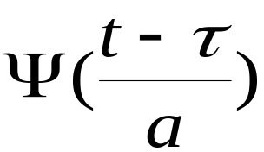
Continuous Wavelet Transform
In a similar way we can think of the above expression as asking the question
“ Is there one these functions
in the given signal and where is it located?”.
The expression is a convolution and this leads to a filtering interpretation
Professor A G Constantinides©

Slide 33
How to Wavelet Transform
Five Easy Steps to a Continuous Wavelet Transform
The continuous wavelet transform is the sum over all time of the signal multiplied by scaled, shifted versions of the wavelet. This process produces wavelet coefficients that are a function of scale and position.
Professor A G Constantinides©

Slide 34
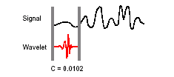
How to Wavelet Transform
1 Take a wavelet and compare it to a section at the start of the original signal.
Professor A G Constantinides©

Slide 35
How to Wavelet Transform
2 Calculate a number, C, that represents how closely correlated the wavelet is with this section of the signal. The higher C is, the more the similarity. Note that the results will depend on the shape of the wavelet you choose.
Professor A G Constantinides©

Slide 36

How to Wavelet Transform
3 Shift the wavelet to the right and repeat steps 1 and 2 until you’ve covered the whole signal.
Professor A G Constantinides©

Slide 37
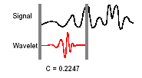
How to Wavelet Transform
4 Scale (stretch) the wavelet and repeat steps 1 through 3.
5 Repeat steps 1 through 4 for all scales.
Professor A G Constantinides©

Slide 38
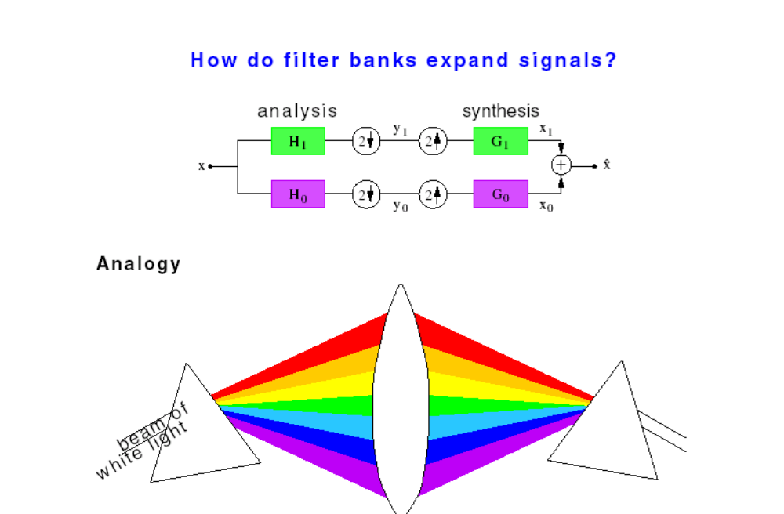
Subband Coding Revisited
Professor A G Constantinides©

Slide 39
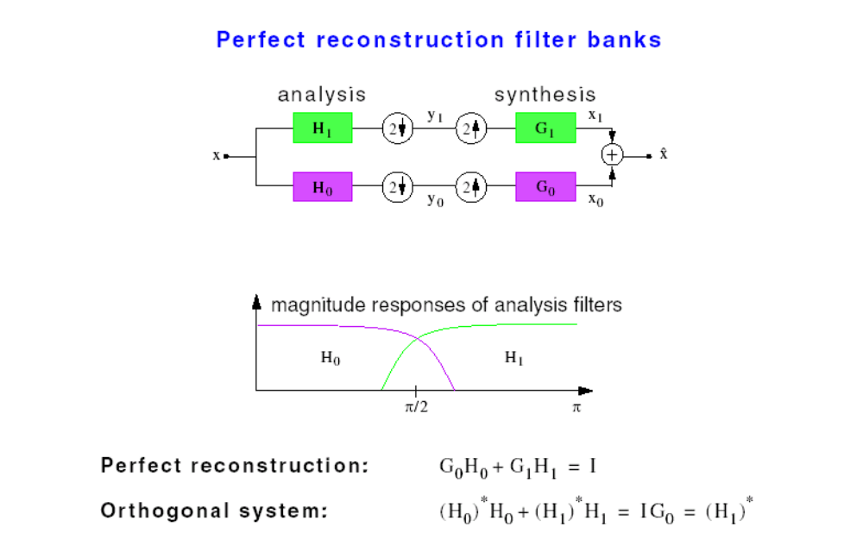
Subband Coding Revisited
Professor A G Constantinides©

Slide 40
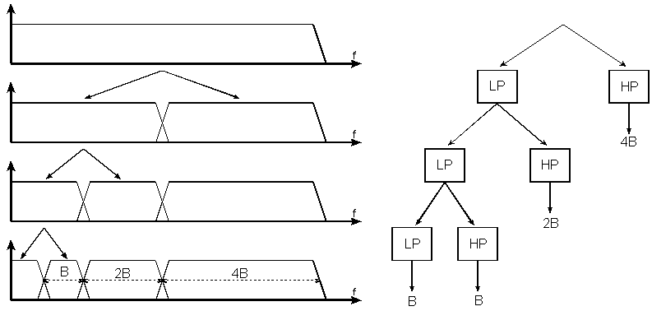
Subband Coding
Split the signal spectrum with a bank of filters as:
Professor A G Constantinides©

Slide 41
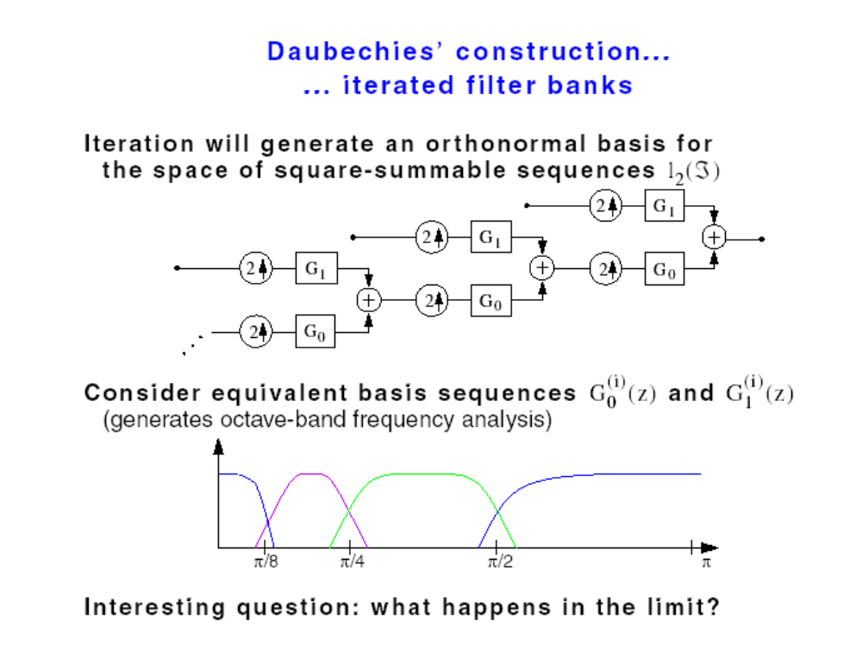
Subband: Reconstruction
Split the signal spectrum with a bank of filters as:
Professor A G Constantinides©

Slide 42
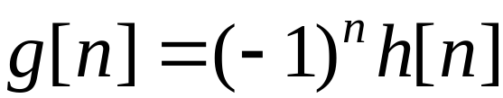
Subband Coding
Arrange for the transfer function of h and for its p-1 first derivatives to vanish at ω=π
Set
This is recognised as the special case of the lowpass to high pass digital filter transformation (Constantinides) for half-band filters
Arrange for g and h to be orthogonal
4) Perfect reconstruction conditions are satisfied (Veterli)
Professor A G Constantinides©

Slide 43
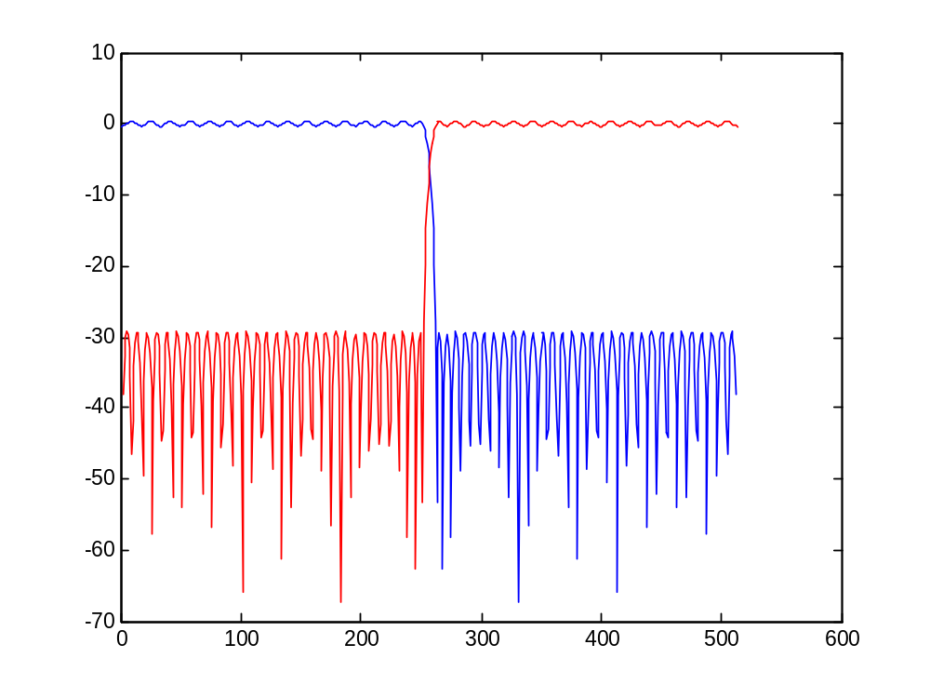
Subband Coding
Professor A G Constantinides©

Slide 44
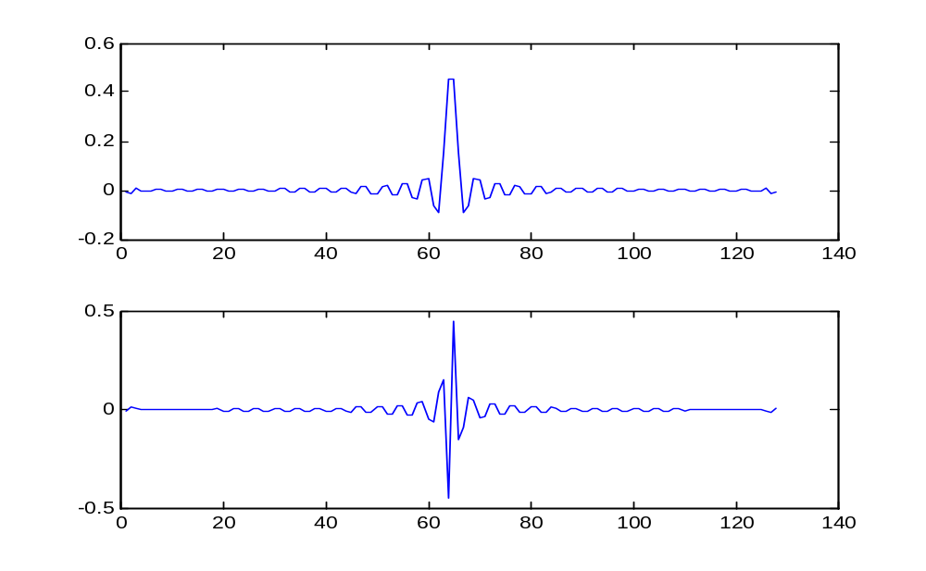
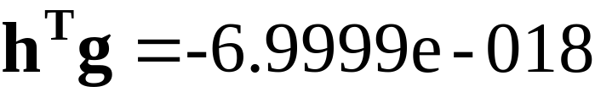
Subband Coding
Professor A G Constantinides©

Slide 45
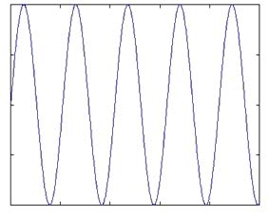
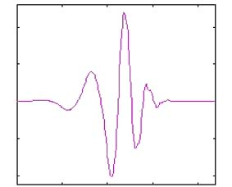
Sine waves and wavelets
Sine wave Wavelet
Smooth
Non-local (stretch out to infinity)
Irregular in shape
Compactly supported (contained in finite domains)
Professor A G Constantinides©

Slide 46
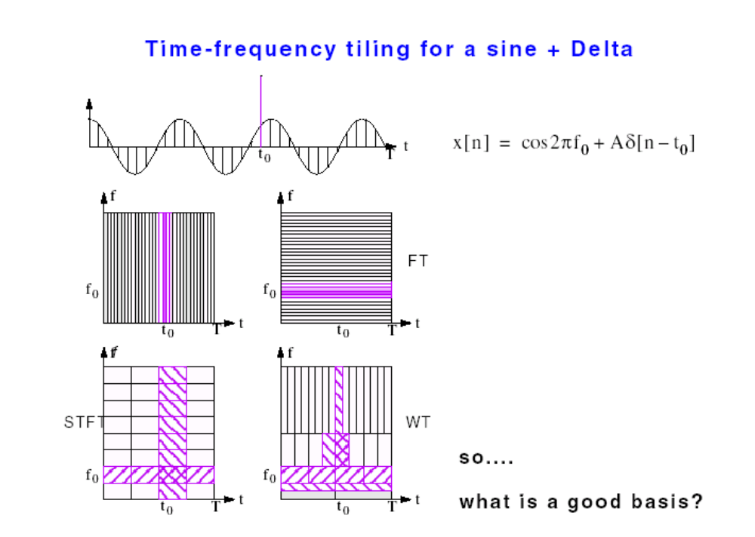
Fourier Transform and DWT
Example:
Professor A G Constantinides©

Slide 47
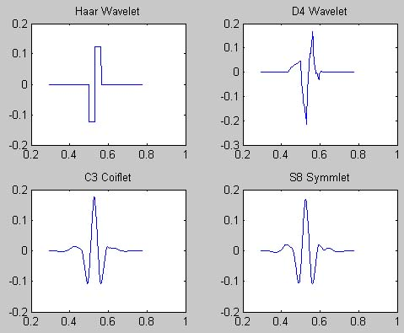
Families of wavelets
Professor A G Constantinides©

Slide 48
Applications of wavelets
Some areas of application :
Image processing
Increasing of quality image, image compression (wavelets are base of MPEG4)
Signal processing :
Noise reduction, compression, coding, analysis of non stationary data
Other examples of wavelet applications are in astronomy, stock market, medicine, nuclear engineering, neurophysiology, music, optics etc.
Professor A G Constantinides©

Slide 49
Basic Wavelet Image Coder
Input
Signal/Image
Compressed
Signal/Image
Source
Encoder
Quantizer
Entropy
Encoder
There are three basic components in current wavelet coders:
A decorrelating transform.
A quantisation procedure
An entropy coding procedure.
Professor A G Constantinides©

Slide 50
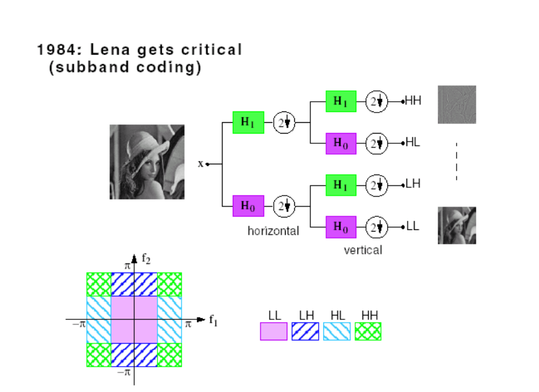
Image Subband Coding
Professor A G Constantinides©

Slide 51
Image Subbands
LL, LH,
LL LL
H,L
LL, LH,
LH LH
L,H H,H
The first letter corresponds to horizontal filtering, the last - to vertical
L,H means, for example, that a lowpass is used in the first stage and a highpass in the second
Professor A G Constantinides©

Slide 52
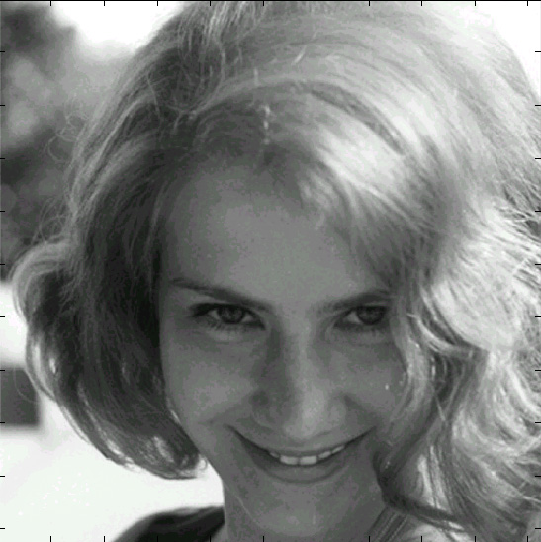
DWT vs. DCT
Original Image
Professor A G Constantinides©

Slide 53
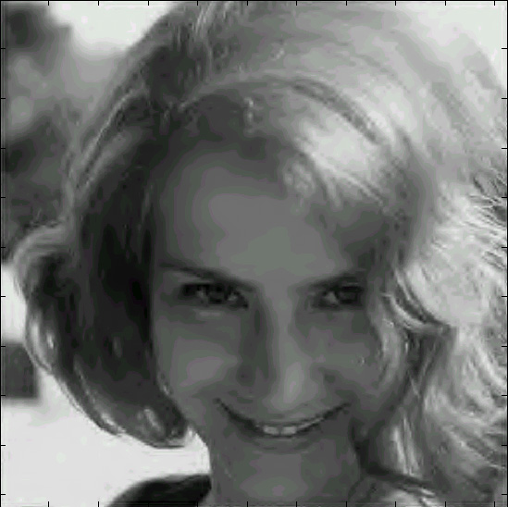
DWT vs. DCT
98% Wavelet Compression
Professor A G Constantinides©

Slide 54
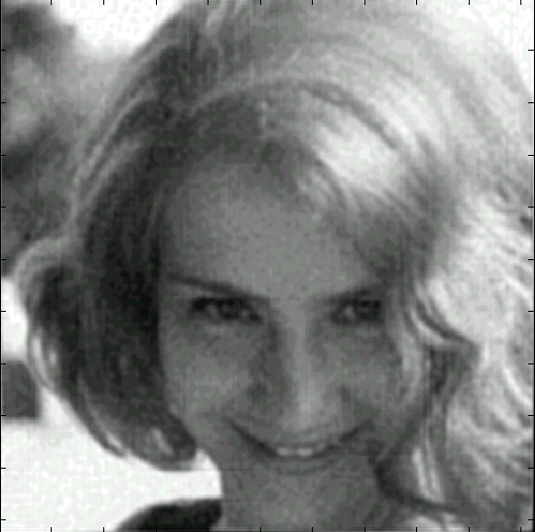
DWT vs. DCT
98% DCT Compression
Professor A G Constantinides©

Slide 55
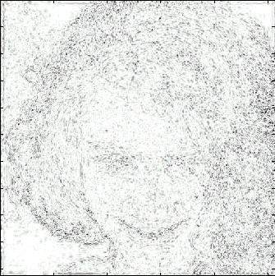
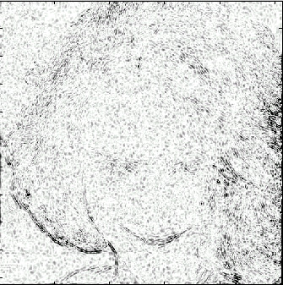
Residual errors
98% Wavelet Compression
98% DCT Compression
Professor A G Constantinides©

Slide 56
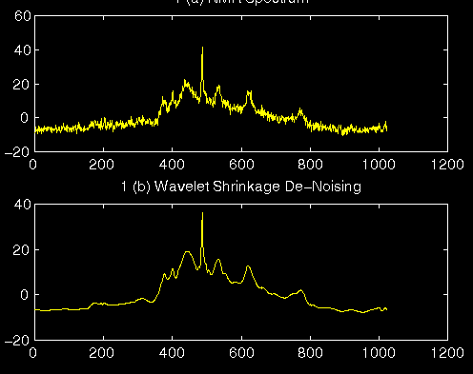
Denoising
A noisy signal and its reconstruction. A threshold on the Wavelets coefficients has been imposed
Professor A G Constantinides©

